Slide 1
Binary search trees

Slide 2
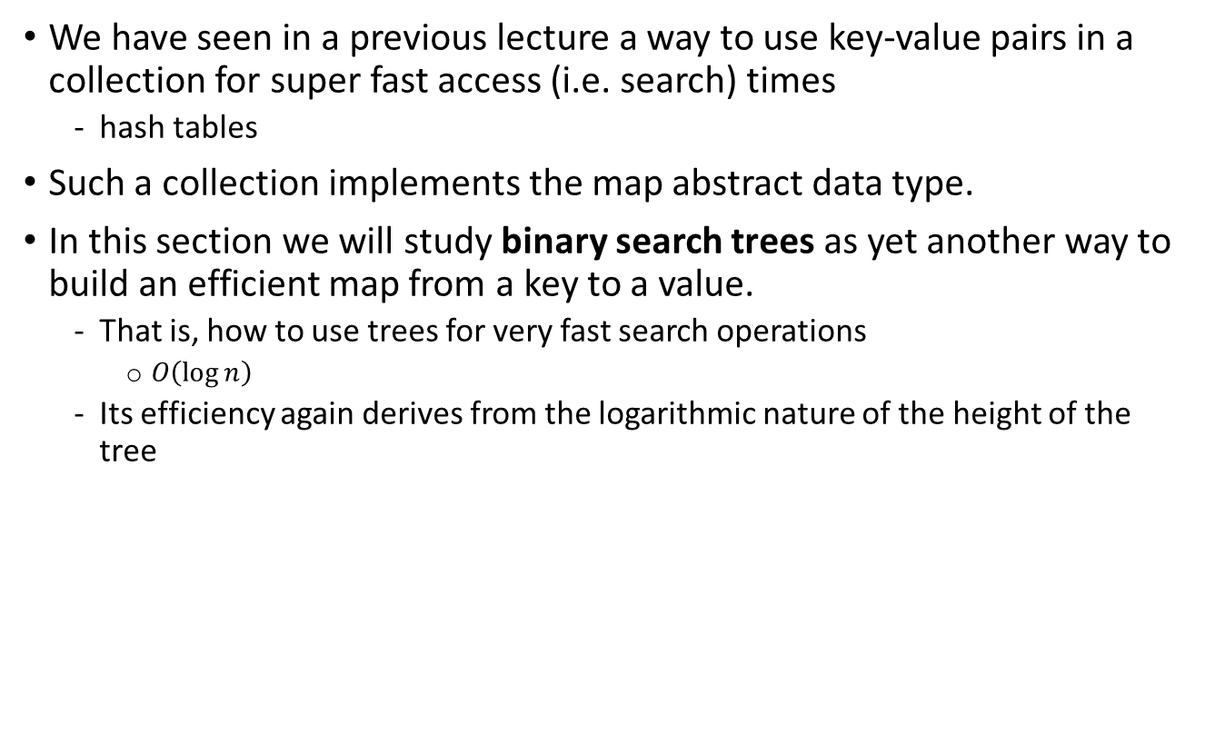
Binary search trees introduction
We have seen in a previous lecture a way to use key-value pairs in a collection for super fast access (i.e. search) times
hash tables
Such a collection implements the map abstract data type.
In this section we will study binary search trees as yet another way to build an efficient map from a key to a value.
That is, how to use trees for very fast search operations
$O\left(\log{n}\right)$
Its efficiency again derives from the logarithmic nature of the height of the tree

Slide 3
0
Level
Elements per level
1
1
2
2
4
3
8
16
4
5
32
6
64
7
128
8
256
9
512
10
1024
Total number of elements in tree: (2$×$number of elements in top level)-1

Slide 4
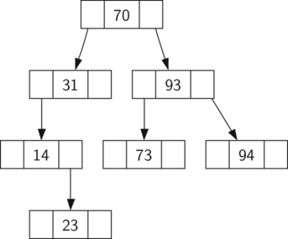
Binary Search Tree (bst Property)
A binary search tree relies on the property that keys that are less than the parent are found in the left subtree, and keys that are greater than the parent are found in the right subtree.
Do not confuse a binary search tree with a binary heap where a parent key is always smaller/larger than its children

Slide 5
Binary search tree implementation
class TreeNode:
def __init__(self,key,val,left=None,right=None, parent=None):
self.key = key
self.payload = val
self.leftChild = left
self.rightChild = right
self.parent = parent
def hasLeftChild(self):
return self.leftChild
def hasRightChild(self):
return self.rightChild
def isLeftChild(self):
return self.parent and self.parent.leftChild == self
def isRightChild(self):
return self.parent and self.parent.rightChild == self
def isRoot(self):
return not self.parent
def isLeaf(self):
return not (self.rightChild or self.leftChild)
def hasAnyChildren(self):
return self.rightChild or self.leftChild
def hasBothChildren(self):
return self.rightChild and self.leftChild
def replaceNodeData(self,key,value,lc,rc):
self.key = key
self.payload = value
self.leftChild = lc
self.rightChild = rc
if self.hasLeftChild():
self.leftChild.parent = self
if self.hasRightChild():
self.rightChild.parent = self
class BinarySearchTree:
def __init__(self):
self.root = None
self.size = 0
def length(self):
return self.size
def __len__(self):
return self.size
def __iter__(self):
return self.root.__iter__()
Binary search tree outer class

Slide 6
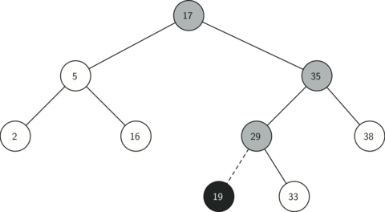
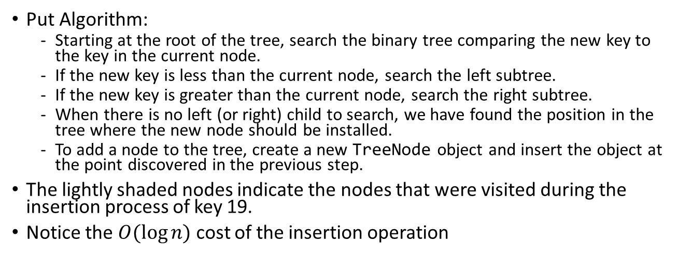
Inserting a new node into a binary search tree
Put Algorithm:
Starting at the root of the tree, search the binary tree comparing the new key to the key in the current node.
If the new key is less than the current node, search the left subtree.
If the new key is greater than the current node, search the right subtree.
When there is no left (or right) child to search, we have found the position in the tree where the new node should be installed.
To add a node to the tree, create a new TreeNode object and insert the object at the point discovered in the previous step.
The lightly shaded nodes indicate the nodes that were visited during the insertion process of key 19.
Notice the $O(\log{n)}$ cost of the insertion operation

Slide 7
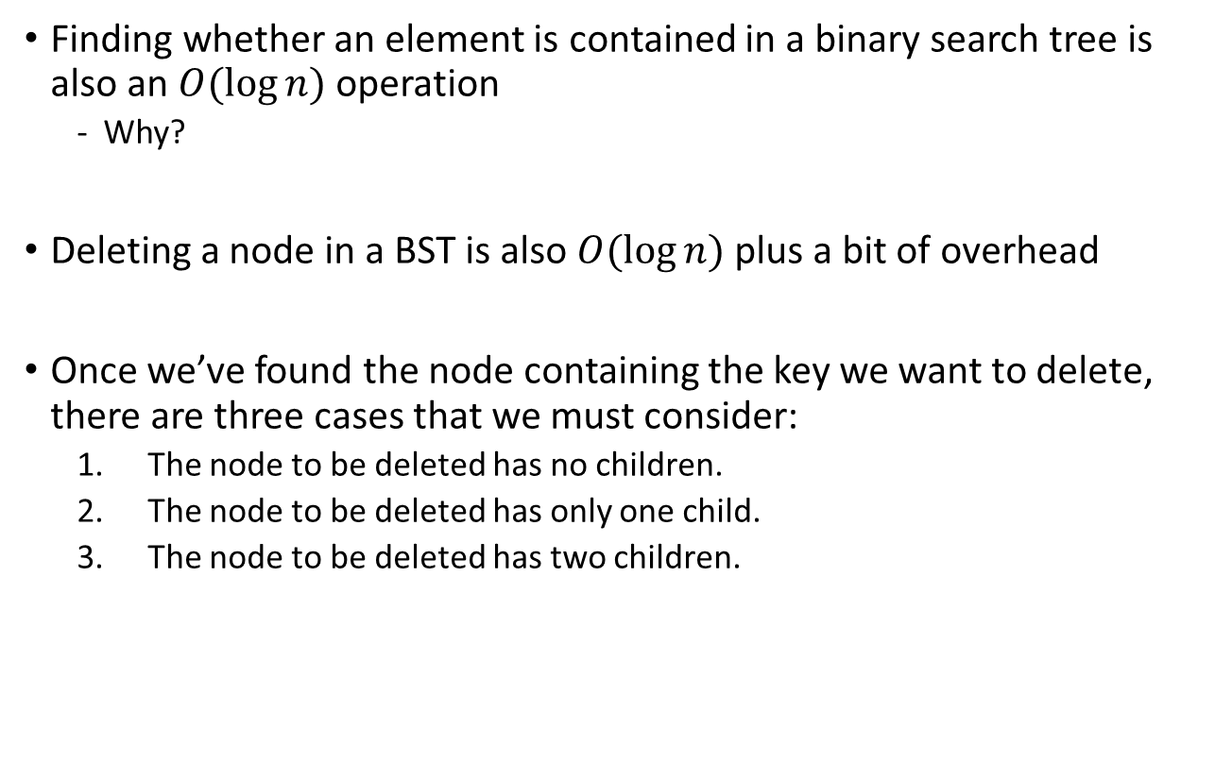
Deleting a node in a binary search tree
Finding whether an element is contained in a binary search tree is also an $O(\log{n)}$ operation
Why?
Deleting a node in a BST is also $O(\log{n)}$ plus a bit of overhead
Once we’ve found the node containing the key we want to delete, there are three cases that we must consider:
The node to be deleted has no children.
The node to be deleted has only one child.
The node to be deleted has two children.

Slide 8
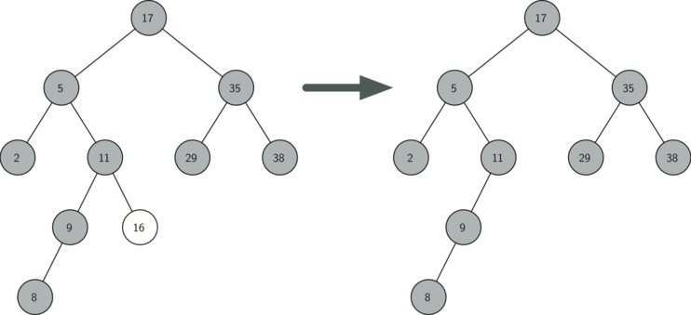
1. The node to be deleted has no children
If the current node has no children all we need to do is delete the node and remove the reference to this node in the parent.

Slide 9
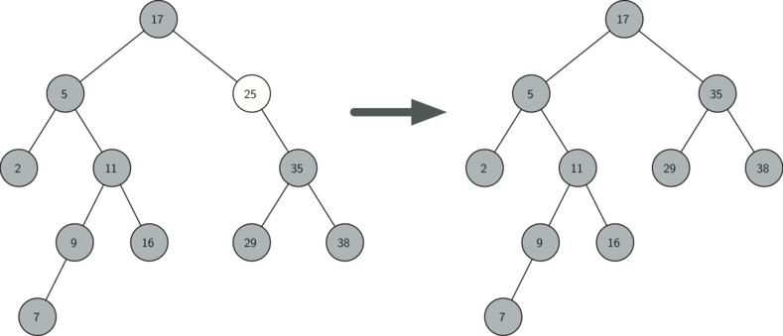
2. The node to be deleted has only one child
The second case is only slightly more complicated.
If a node has only a single child, then we can simply promote the child to take the place of its parent.

Slide 10
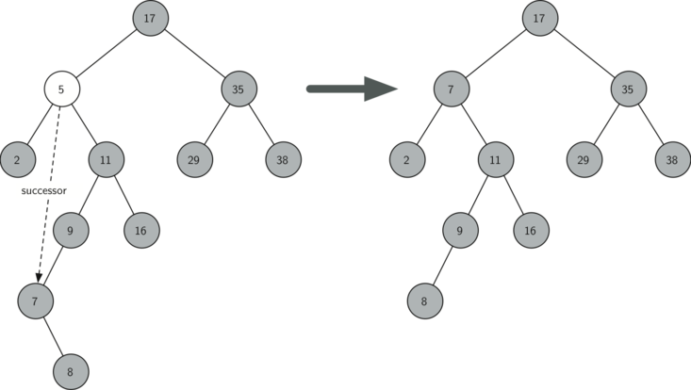
3. The node to be deleted has two children
The third case is the most difficult case to handle.
If a node has two children, then it is unlikely that we can simply promote one of them to take the node’s place.
We can, however, search the tree for a node that can be used to replace the one scheduled for deletion.
What we need is a node that will preserve the binary search tree relationships for both of the existing left and right subtrees.
The node that will do this is the node that has the next-largest key in the tree.
We call this node the successor

Slide 11
3. The node to be deleted has two children
The successor is guaranteed to have no more than one child, so we know how to remove it using the two cases for deletion that we have already implemented.
Why is it warranted to have no more than one child?
If it would have 2 children, one would be smaller (bst property), and therefore this node would not be the successor with the next largest key in the tree
Once the successor has been removed, we simply put it in the tree in place of the node to be deleted.

Slide 12
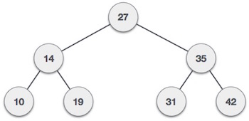
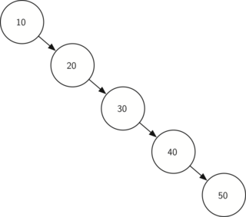
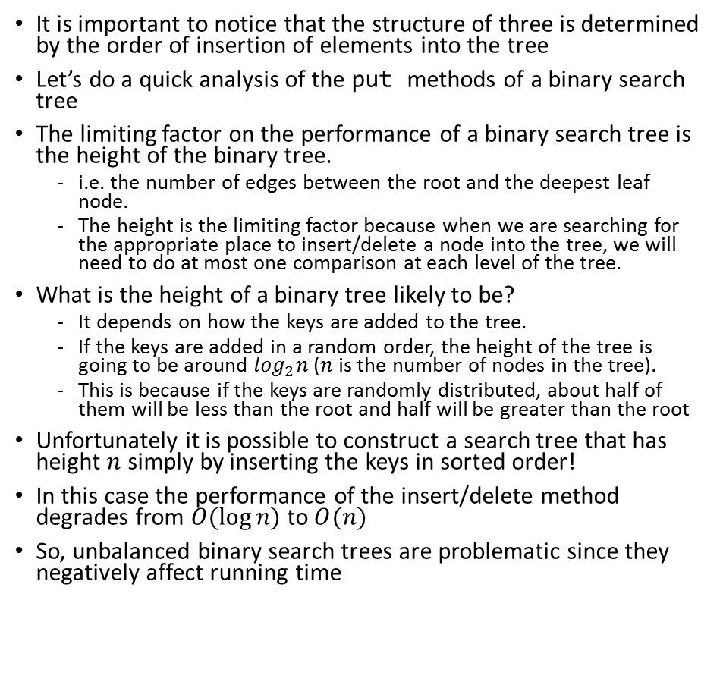
Search tree analysis
[27, 14, 10, 35,19,42,31]
It is important to notice that the structure of three is determined by the order of insertion of elements into the tree
Let’s do a quick analysis of the put methods of a binary search tree
The limiting factor on the performance of a binary search tree is the height of the binary tree.
i.e. the number of edges between the root and the deepest leaf node.
The height is the limiting factor because when we are searching for the appropriate place to insert/delete a node into the tree, we will need to do at most one comparison at each level of the tree.
What is the height of a binary tree likely to be?
It depends on how the keys are added to the tree.
If the keys are added in a random order, the height of the tree is going to be around $\log_{2}n$ ($n$is the number of nodes in the tree).
This is because if the keys are randomly distributed, about half of them will be less than the root and half will be greater than the root
Unfortunately it is possible to construct a search tree that has height $n$ simply by inserting the keys in sorted order!
In this case the performance of the insert/delete method degrades from $O(\log{n)}$ to$O(n)$
So, unbalanced binary search trees are problematic since they negatively affect running time
[10, 20, 30, 40, 50]
Notes:
The number of nodes at any particular level is $2^{d}$where $d$ is the depth of the level

Slide 13
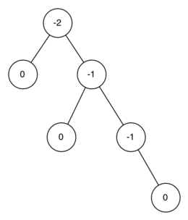
Balanced Binary Search Trees: AVL Trees
A special kind of binary search tree that automatically makes sure that the tree remains balanced at all times is called an AVL tree
Notice that AVL trees do NOT enforce the property of Binary Search Trees (left subtree has smaller key the parent and right subtree has larger key)
AVL tree implementations simply enforce the tree remains balanced
To implement a AVL tree we need to keep track of a balance factor for each node in the tree.
We do this by looking at the heights of the left and right subtrees for each node.
Using the definition for balance factor given above we say that a subtree is left-heavy if the balance factor is greater than zero.
If the balance factor is less than zero then the subtree is right-heavy.
If the balance factor is zero then the tree is perfectly in balance.
For purposes of implementing an AVL tree, and gaining the benefit of having a balanced tree we will define a tree to be in balance if the balance factor is -1, 0, or 1.
Once the balance factor of a node in a tree is outside this range we will need to have a procedure to bring the tree back into balance
Notes:
The AVL tree is named after its inventors: G.M. Adelson-Velskii and E.M. Landis.

Slide 14
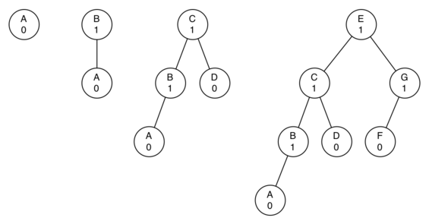
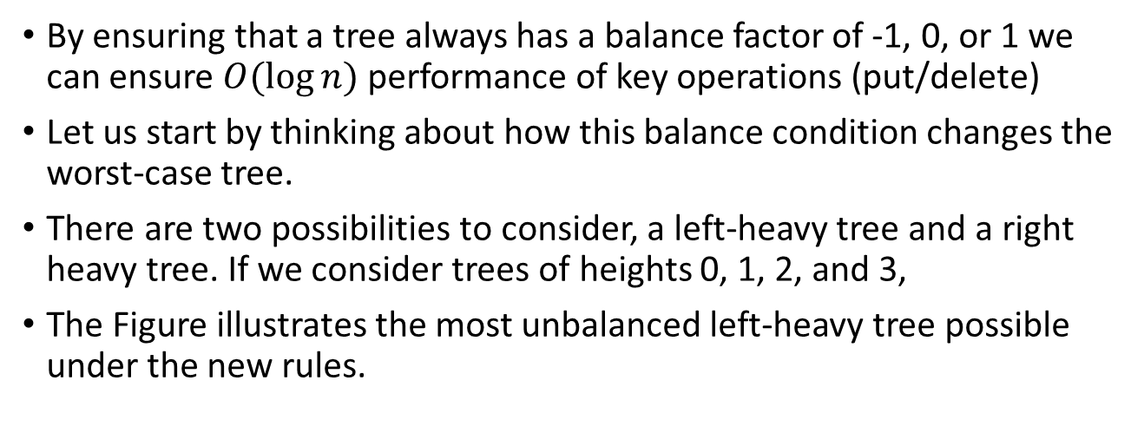
AVL Tree Performance
By ensuring that a tree always has a balance factor of -1, 0, or 1 we can ensure $O(\log{n)}$ performance of key operations (put/delete)
Let us start by thinking about how this balance condition changes the worst-case tree.
There are two possibilities to consider, a left-heavy tree and a right heavy tree. If we consider trees of heights 0, 1, 2, and 3,
The Figure illustrates the most unbalanced left-heavy tree possible under the new rules.

Slide 15
AVL Tree Implementation
How do we insert a new key into an AVL Tree?
Since all new keys are inserted into the tree as leaf nodes and we know that the balance factor for a new leaf is zero, there are no new requirements for the node that was just inserted.
But once the new leaf is added we must update the balance factor of its parent.
How this new leaf affects the parent’s balance factor depends on whether the leaf node is a left child or a right child.
If the new node is a right child the balance factor of the parent will be reduced by one.
If the new node is a left child then the balance factor of the parent will be increased by one.
This relation can be applied recursively to the grandparent of the new node, and possibly to every ancestor all the way up to the root of the tree.

Slide 16
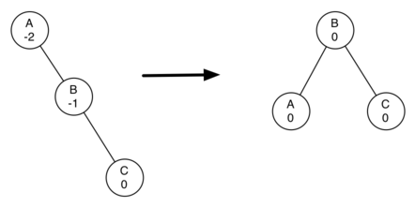
What to do when the tree becomes unbalanced? Carry out a rotation to balance nodes with large positive or negative balance factors
When a rebalancing of the tree is necessary, how do we do it?
Efficient rebalancing is the key to making the AVL Tree work well without sacrificing performance.
In order to bring an AVL Tree back into balance we will perform one or more rotations on the tree.
To perform a left rotation we essentially do the following:
Promote the right child (B) to be the root of the subtree.
Move the old root (A) to be the left child of the new root.
If new root (B) already had a left child then make it the right child of the new left child (A). Note: Since the new root (B) was the right child of A the right child of A is guaranteed to be empty at this point. This allows us to add a new node as the right child without any further consideration.

Slide 17
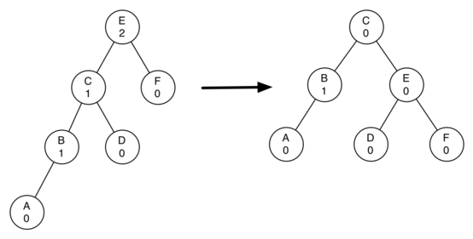
What to do when the tree becomes unbalanced? Carry out a rotation to balance nodes with large positive or negative balance factors
To perform a right rotation we essentially do the following:
Promote the left child (C) to be the root of the subtree.
Move the old root (E) to be the right child of the new root.
If the new root(C) already had a right child (D) then make it the left child of the new right child (E). Note: Since the new root (C) was the left child of E, the left child of E is guaranteed to be empty at this point. This allows us to add a new node as the left child without any further consideration.

Slide 18
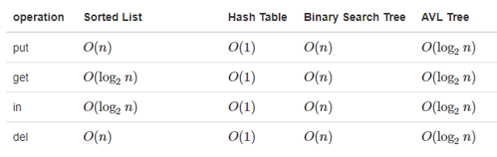
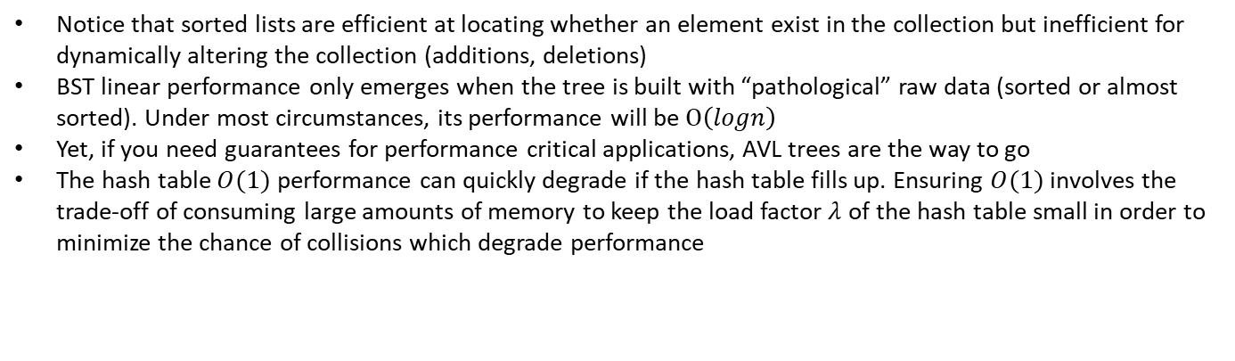
Performance guarantees of each Map Abstract Data Type Implementations
All data structures that can be used to implement the map abstract data type (key value pairs) basically boil down to being able to efficiently searching for whether an object exist in a collection and being able to dynamically update the collection.
Notice that sorted lists are efficient at locating whether an element exist in the collection but inefficient for dynamically altering the collection (additions, deletions)
BST linear performance only emerges when the tree is built with “pathological” raw data (sorted or almost sorted). Under most circumstances, its performance will be $O\left(logn\right)$
Yet, if you need guarantees for performance critical applications, AVL trees are the way to go
The hash table $O(1)$ performance can quickly degrade if the hash table fills up. Ensuring $O(1)$ involves the trade-off of consuming large amounts of memory to keep the load factor $λ$ of the hash table small in order to minimize the chance of collisions which degrade performance

